Slide 1
SOFTWARE TESTING

Slide 2
Introduction to Software Testing
What is Software Testing
“Software testing is a process of executing the application with the intent of finding the defects by comparing the output behavior of the application with expected behavior (requirement).”
In other words it’s comparing the actual behavior of an application with expected behavior.

Slide 3
Why Software Testing
Humans make mistakes all the time!!
“Software testing is really required to point out the defects and errors that were made during the development phases”.
We humans can’t identify our mistakes in a work done by us. We should get someone else to check our work because another person may identify the mistakes done by us. In the same way software developers may not identify the mismatches in a program or application implemented by them which can be identify by the another department called Software Test Engineer.

Slide 4
Benefits of Software Testing
“Software testing helps in finalizing the software application against business requirements.”
Software testing makes sure that the testing is being done properly and hence the system is ready for the customers to use.
Below are few benefits of software testing.
Finding the defects before delivery
Gaines the confidence about quality
To Prevent defects
Ensure the requirements are delivered to client
4. What is Quality
“Software quality is nothing but delivering a bug free application and delivered on time with all requirements.”

Slide 5
What is defect
“A defect is a deviation or mismatch from the requirements”.
When actual result deviates from the expected result while testing a software application or product then it results into a defect. Hence, any deviation from the specification mentioned in the functional specification document is a defect. In different organizations it’s called differently like bug, issue, incidents or problem.

Slide 6
Project Vs Product
“Project is developed for a single customer on his own requirements by the software companies and the project will be used by the customer only.”
“Product is developed for multiple customers on their consolidated requirements by the software companies and the product will be used by all customers.”

Slide 7
Software Testing Types:
MANUAL TESTING
AUTOMATION TESTING
Test Automation Tools:
Quick Test Professional By HP
Rational Functional Tester By Rational (IBM Company)
Silk Test By Borland
Test Complete By Automated QA
QA Run (Compuware )
Watir ( Open Source)
Selenium ( Open Source)
Sahi (Open Source)

Slide 8
What are the different types of Software Testing?
Manual Testing: Manual testing is the process of testing software by hand to learn more about it, to find what is and isn’t working. This usually includes verifying all the features specified in requirements documents, but often also includes the testers trying the software with the perspective of their end user’s in mind. Manual test plans vary from fully scripted test cases, giving testers detailed steps and expected results, through to high-level guides that steer exploratory testing sessions. There are lots of sophisticated tools on the market to help with manual testing, but if you want a simple and flexible place to start, take a look at Testpad.
Automation Testing: Automation testing is the process of testing the software using an automation tool to find the defects. In this process, testers execute the test scripts and generate the test results automatically by using automation tools. Some of the famous automation testing tools for functional testing are QTP/UFT and Selenium.

Slide 9
MANUAL TESTING

Slide 10
Software Development Life Cycle (SDLC)
What is Software Development Life Cycle
“SDLC is a process followed for a software project, within a software organization. It consists of a detailed plan describing how to develop, maintain, replace and alter or enhance specific software”
Why Software Development Life Cycle
“SDLC ensure success in process of software development.”

Slide 11
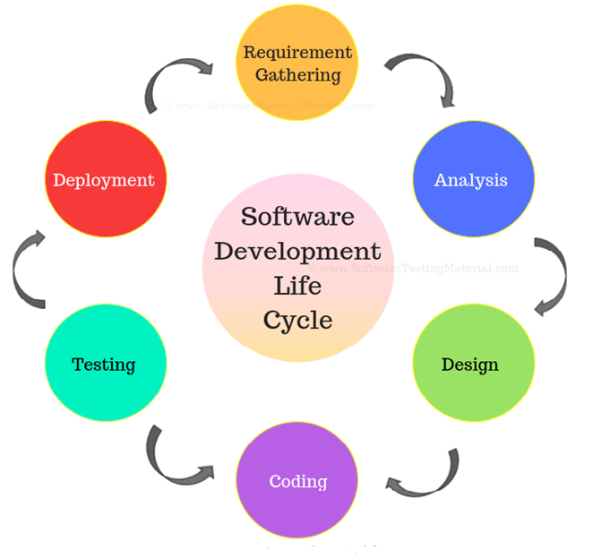

Slide 12
1. Requirement / Initial
Business requirements are gathered in this phase. “
This phase is the main focus of the project managers and stake holders. Meetings with managers, stake holders and users are held in order to determine the requirements like;
Who is going to use the system?
How will they use the system?
What data should be input into the system?
What data should be output by the system?
Roles Involved: Business Analyst (BA), System Architects
Outcome: System Requirement Specification (SRS)

Slide 13
2. Analysis
“After requirement gathering these requirements are analyzed for their validity and the possibility of developing the requirements in the system.”
Requirement analysis is the most important and fundamental stage in SDLC. It is performed by both development team and testing team.
Roles Involved: Dev & QA team, Architects, Project Managers
Outcome: Final SRS approved by customer, Technology selection for both Dev & QA

Slide 14
3. Design
“During this part of the design phase, the consultants/architects break down the system into pieces that can be programmed.”
System Design helps in specifying hardware and system requirements and also helps in defining overall system architecture. The system design specifications serve as input for the next phase of the model.
Roles Involved: Architects & Team
Outcome: Technical Design Document (TDD)

Slide 15
Coding
“The actual development starts and the product is built in coding phase. “
The work is divided in modules/units and actual coding is started in this coding phase and it is the main focus for developer. Coding is one of the longest phase of SDLC.
Roles involved: Developers and Architects
Outcome: Programs or Application or Module

Slide 16
Testing
“In Testing phase testers execute the test cases against the application, report the defects and retested the fixed defects. “
During this phase unit testing, integration testing, system testing, acceptance testing are done.
Roles Involved: Testers, Developers
Outcome: Defects, Test Summary Report, Test Plan, Test Case document

Slide 17
Deployment / Delivery & Maintenance
“Delivery: After successful testing the product is delivered /deployed to the client.
During the Delivery phase, customer will perform user acceptance testing (UAT) in a real time environment.
Once when the customers starts using the developed system then the actual problems comes up and needs to be solved from time to time. This process where the care is taken for the developed product is known as maintenance.
Roles Involved: Testers, Developers, Customer, Business team, Architects, Project Manager, and Delivery Manager
Outcome: Quality Product, Enhancements &Production Issues (Maintenance)

Slide 18
Software Development Life Cycle (SDLC) Models
“There are many development models life that have cycle been developed in order to achieve different required objectives.”
Waterfall Model in SDLC
Spiral Model in SDLC
V Model in SDLC
Agile Scrum Methodology

Slide 19
1 .Water Fall Model
The Waterfall Model was first Process Model to be introduced. It is also referred to as a linear-sequential life cycle model. It is very simple to understand and use. This type of model is basically used for the project which is small and there are no uncertain requirements.

Slide 20
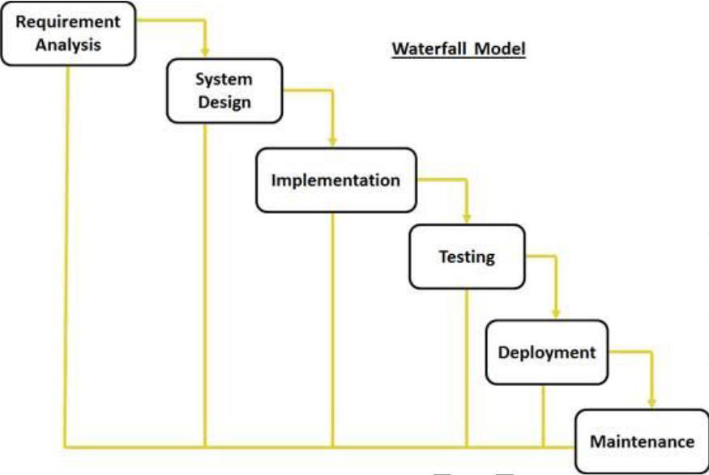

Slide 21
Advantages of waterfall model:
- This model is simple and easy to understand and use.
- It is easy to manage due to the rigidity of the model
- In this model phases are processed and completed one at a time.

Slide 22
Disadvantages of waterfall model:
- Once an application is in the testing stage, it is very difficult to go back and change
- No working software is produced until late during the life cycle.
- High amounts of risk
- Not a good model for complex and object-oriented projects.
- Poor model for long and ongoing projects.
When to use the waterfall model:
- This model is used only when the requirements are very well known, clear and fixed.
- The project is short.

Slide 23
2. V Model
“The - Vmodel is a SDLC model where execution of processes happens in a sequential manner in V-shape. “
V-Shaped life cycle is a sequential path of execution of processes. Each phase must be completed before the next phase begins.
Testing of the product is planned in parallel with a corresponding phase of development.

Slide 24
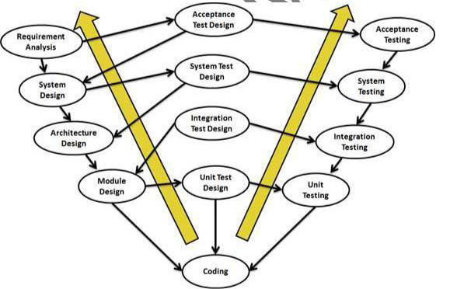

Slide 25
Advantages of V-model:
- Simple and easy to use.
- Testing activities like planning, test designing happens well before coding. This saves a lot of time.
- Proactive defect tracking – that is defects are found at early stage.
Disadvantages of V-model:
- Software is developed during the implementation phase, so no early prototypes of the software are produced.
- If any changes happen in midway, then the test documents along with requirement documents has to be updated.

Slide 26
When to use the V-model:
- The V-shaped model should be used for small to medium sized projects where requirements are clearly defined and fixed.
- The V-Shaped model should be chosen when sample technical resources are available with needed technical expertise.

Slide 27
Spiral Model:
Planning Phase – Requirement Gathering, Cost Estimation, Resource Allocation Risk Analysis Phase – Strengths and weaknesses of the project Design Phase – Coding, Internal Testing and deployment Evaluation Phase – Client Evaluation (Client-side Testing) to get the feedback

Slide 28
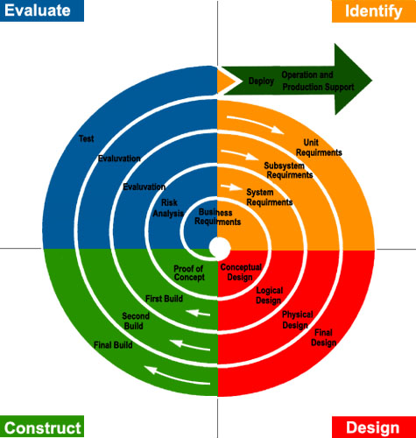

Slide 29
Advantages:
It allows requirement changes
Suitable for large and complicated projects
It allows better risk analysis
Cost effective due to good risk management
Disadvantages:
Not suitable for small projects
The success of the project depends on the risk analysis phase
Have to hire more experienced resource especially for risk analysis

Slide 30
Agile Model
Agile SDLC methodology is based on collaborative decision making between requirements and solutions teams, and a cyclical, iterative progression of producing working software. Work is done in regularly iterated cycles, known as sprints, that usually last two to four weeks.
Advantages of Agile model:
- Customer satisfaction by continuous delivery of software.
- Customers, developers and testers constantly interact with each other.
- Working software is delivered frequently
- Continuous attention to technical excellence and good design.
- Even late changes in requirements are welcomed

Slide 31
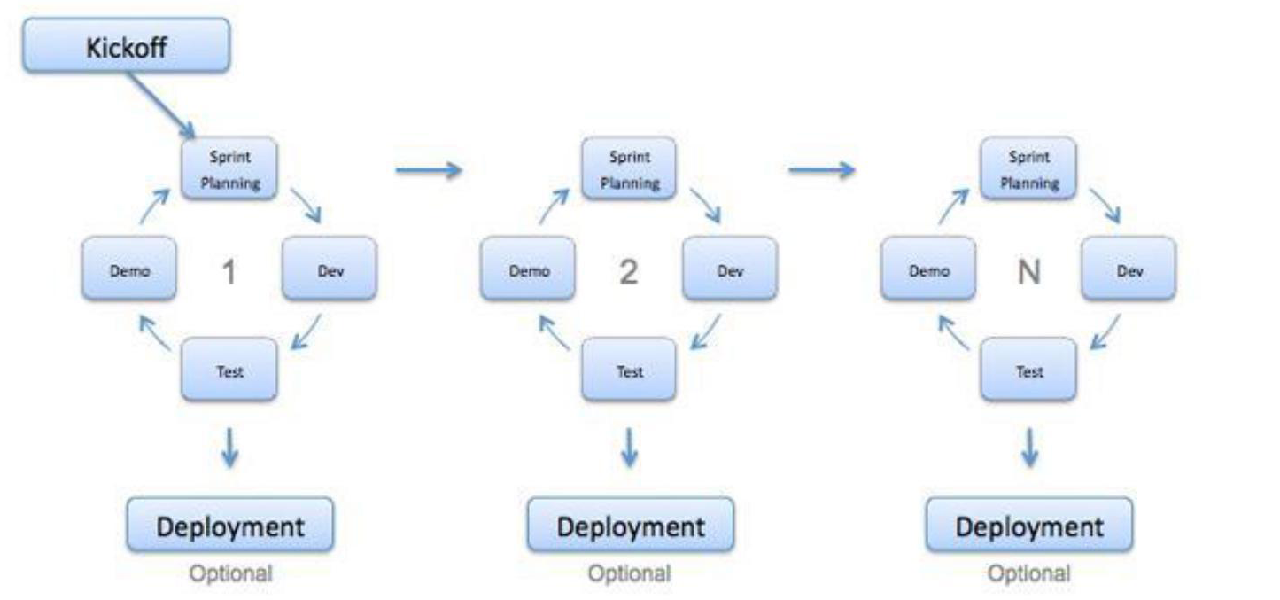

Slide 32
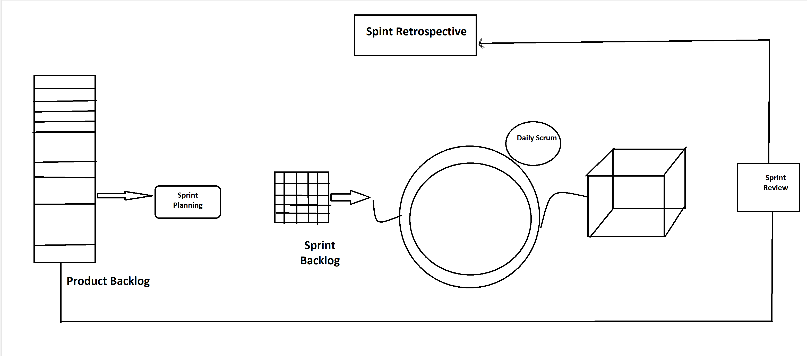

Slide 33
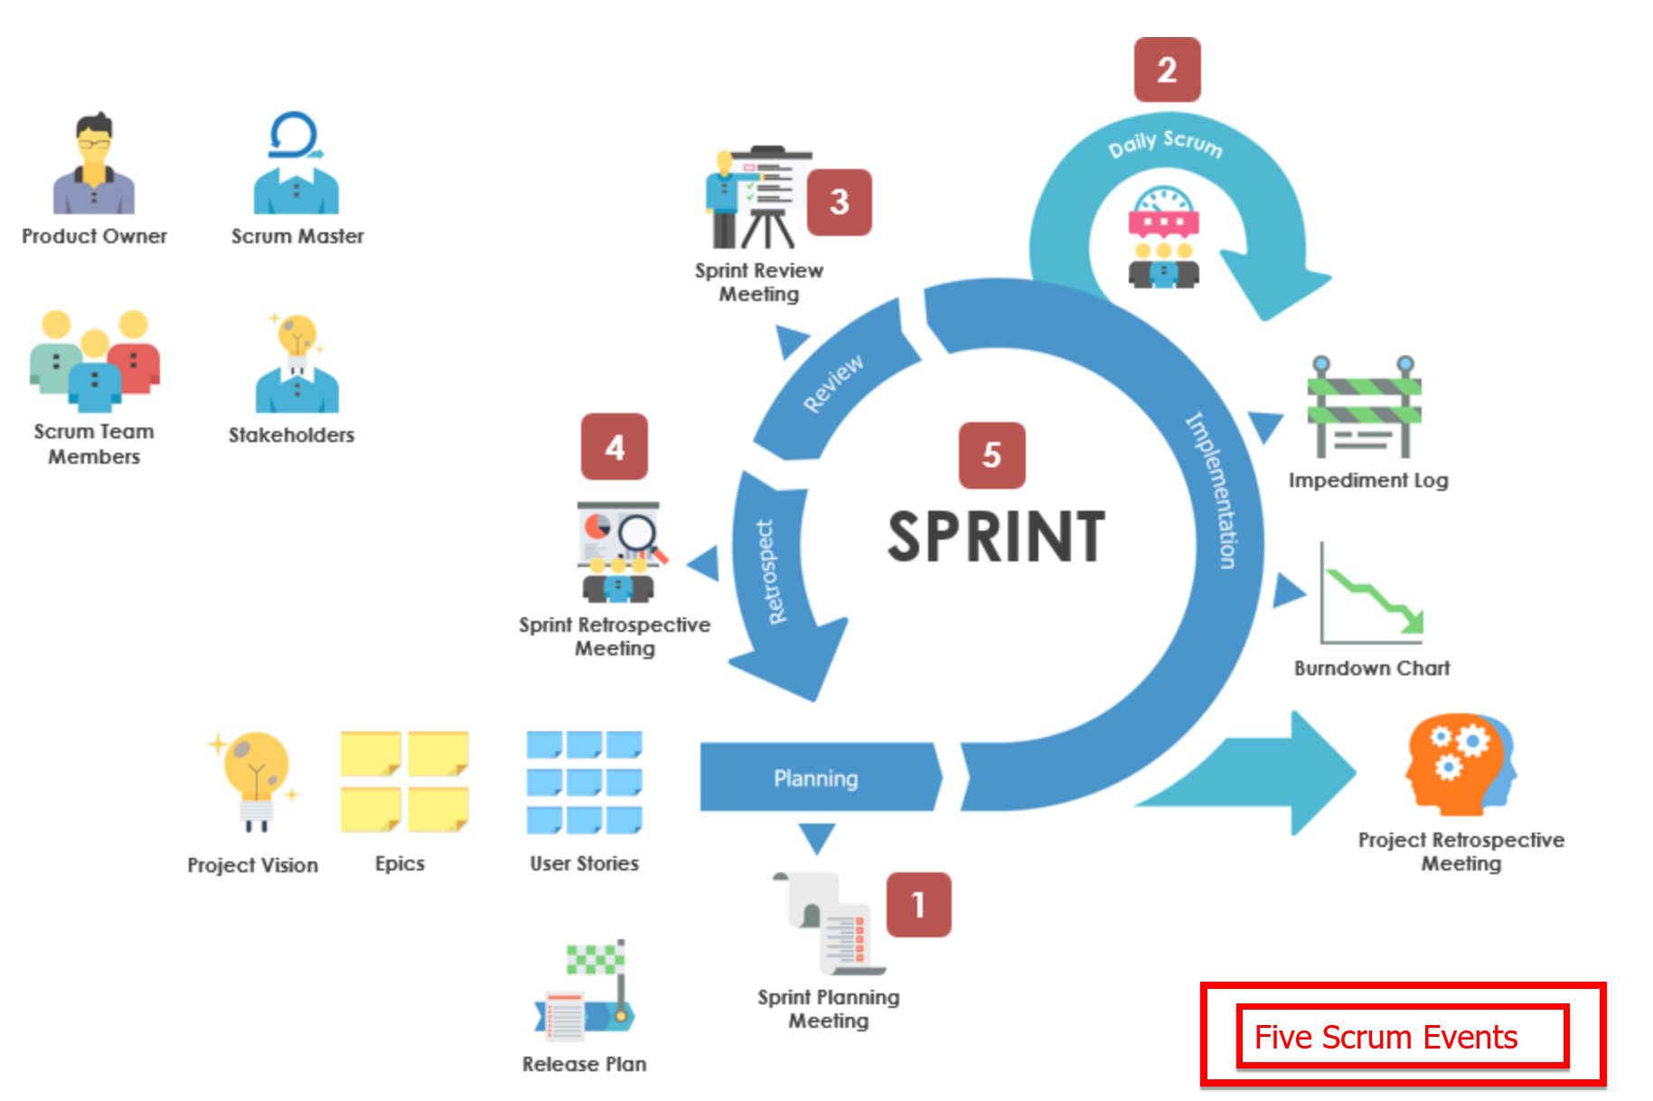

Slide 34
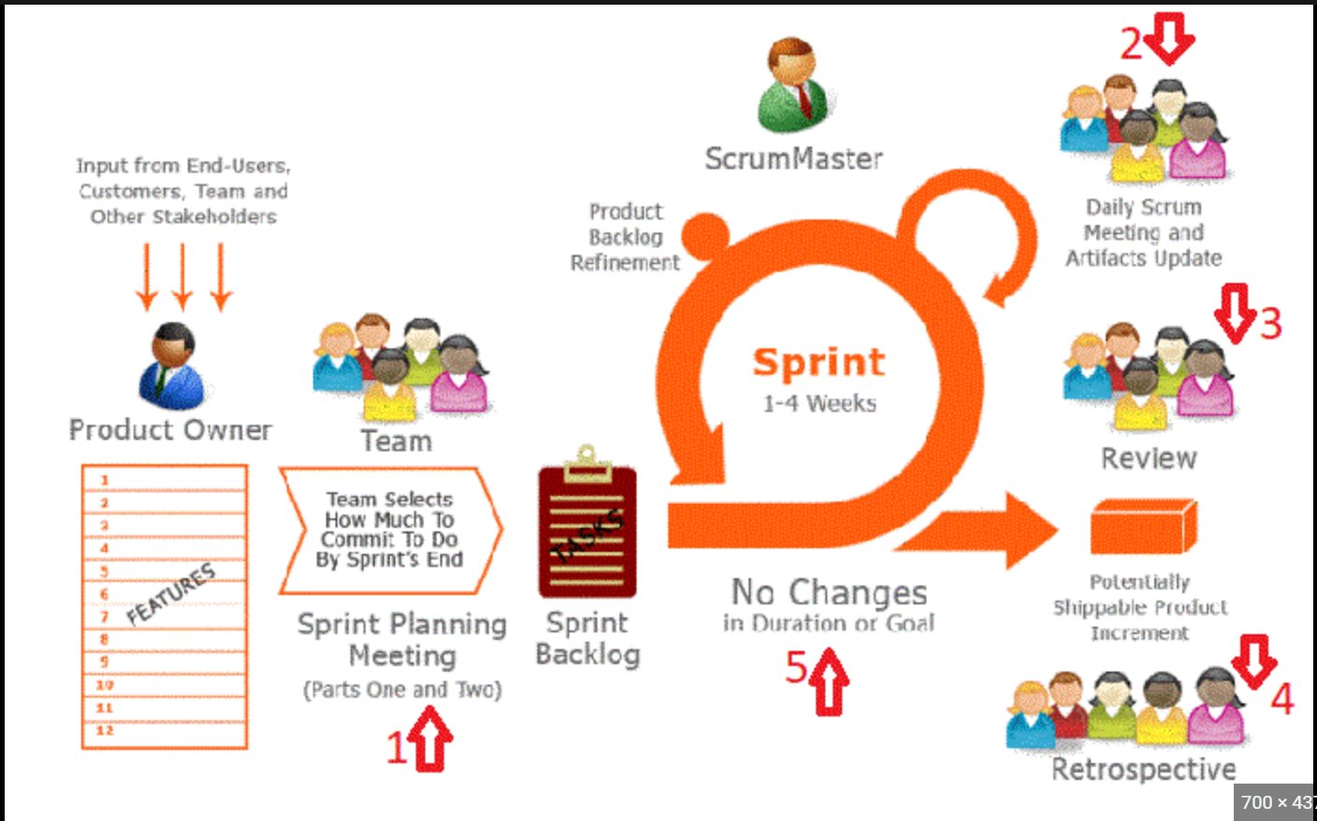

Slide 35
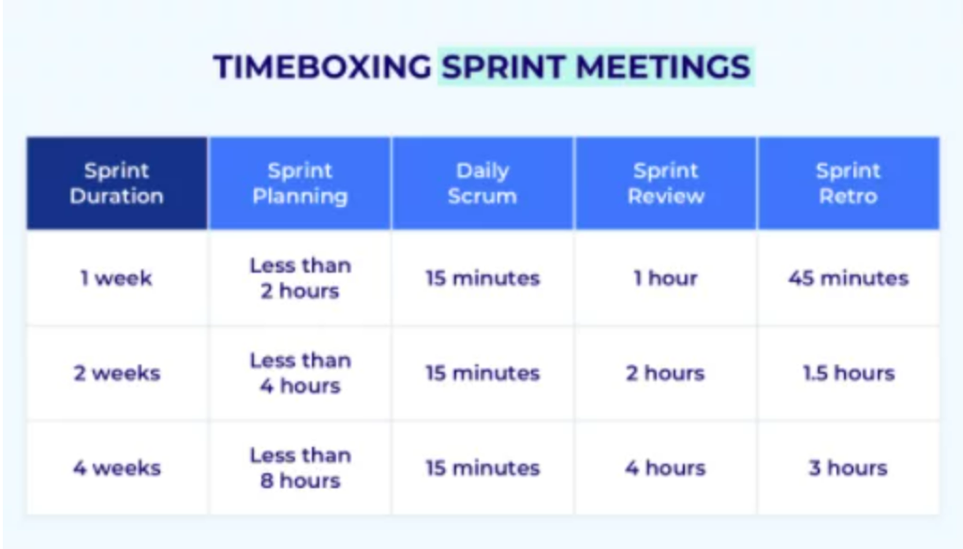

Slide 36
Disadvantages of Agile model:
- It is difficult to assess the effort required at the beginning of the software development life cycle.
- The project can easily get taken off track if the customer representative is not clear what final outcome that they want.
- Only senior programmers are capable of taking the kind of decisions required during the development process.
When to use Agile model:
- New changes can be implemented at very little cost
- To implement a new feature the developers need to lose only the work of a few days.
- Unlike the waterfall model in agile model very limited planning is required to get started with the project.

Slide 37
What is Software Testing Life Cycle (STLC)
Software Testing Life Cycle:
Software Testing Life Cycle (STLC) identifies what test activities to carry out and when to accomplish those test activities. Even though testing differs between organizations, there is a testing life cycle.

Slide 38
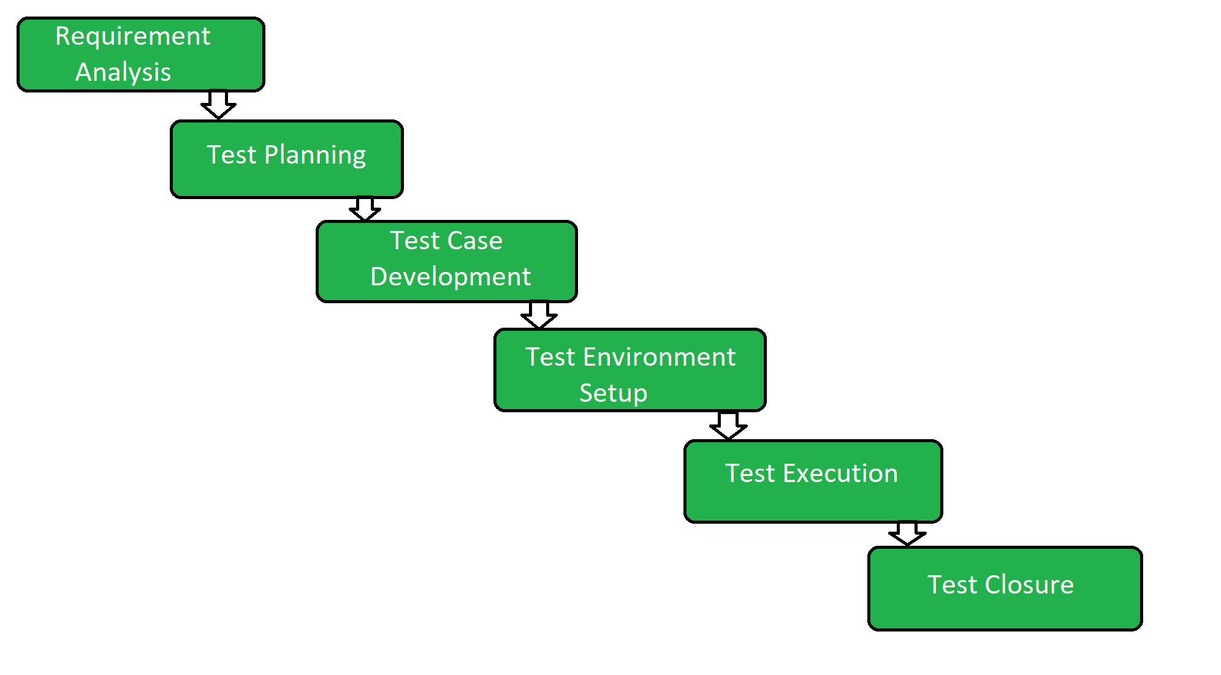

Slide 39
Requirement Analysis:
The entry criteria for this phase is the BRS (Business Requirement Specification) document. During this phase, test team studies and analyzes the requirements from a testing perspective. This phase helps to identify whether the requirements are testable or not. If any requirement is not testable, the test team can communicate with various stakeholders (Client, Business Analyst, Technical Leads, System Architects, etc) during this phase so that the mitigation strategy can be planned.
Entry Criteria: BRS (Business Requirement Specification) Deliverables: List of all testable requirements, Automation feasibility report (if applicable)

Slide 40
Test Planning:
Test planning is the first step of the testing process. In this phase typically Test Manager/Test Lead involves determining the effort and cost estimates for the entire project. Preparation of the Test Plan will be done based on the requirement analysis. Activities like resource planning, determining roles and responsibilities, tool selection (if automation), training requirement, etc., carried out in this phase. The deliverables of this phase are Test Plan & Effort estimation documents.
Entry Criteria: Requirements Documents Deliverables: Test Strategy, Test Plan, and Test Effort estimation document.

Slide 41
Test Design:
The test team starts with test case development activity here in this phase. Test team prepares test cases, test scripts (if automation), and test data. Once the test cases are ready then these test cases are reviewed by peer members or team lead. Also, the test team prepares the Requirement Traceability Matrix (RTM). RTM traces the requirements to the test cases that are needed to verify whether the requirements are fulfilled. The deliverables of this phase are Test Cases, Test Scripts, Test Data, Requirements Traceability Matrix
Entry Criteria: Requirements Documents (Updated version of unclear or missing requirement) Deliverables: Test cases, Test Scripts (if automation), Test data.

Slide 42
Test Environment Setup:
This phase can be started in parallel with the Test design phase. The test environment setup is done based on the hardware and software requirement list. In some cases, the test team may not be involved in this phase. The development team or customer provides the test environment. Meanwhile, the test team should prepare the smoke test cases to check the readiness of the given test environment.
Entry Criteria: Test Plan, Smoke Test cases, Test Data Deliverables: Test Environment. Smoke Test Results.

Slide 43
Test Execution:
The test team starts executing the test cases based on the planned test cases. If a test case result is Pass/Fail then the same should be updated in the test cases. The defect report should be prepared for failed test cases and should be reported to the Development Team through a bug tracking tool (eg., Quality Center) for fixing the defects. Retesting will be performed once the defect was fixed. Click here to see the Bug Life Cycles.
Entry Criteria: Test Plan document, Test cases, Test data, Test Environment. Deliverables: Test case execution report, Defect report, RTM(Requirement Traceability Matrix)

Slide 44
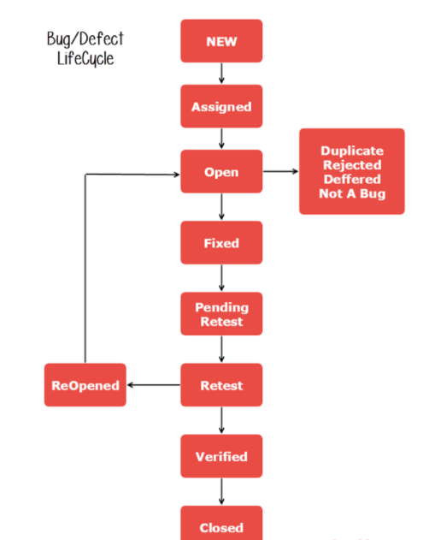

Slide 45
Test Closure:
The final stage where we prepare Test Closure Report, Test Metrics. The testing team will be called out for a meeting to evaluate cycle completion criteria based on Test coverage, Quality, Time, Cost, Software, Business objectives. Test team analyses the test artifacts (such as Test cases, Defect reports, etc.,) to identify strategies that have to be implemented in the future, which will help to remove process bottlenecks in the upcoming projects. Test metrics and Test closure report will be prepared based on the above criteria.
Entry Criteria: Test Case Execution report (make sure there are no high severity defects opened), Defect report Deliverables: Test Closure report, Test metrics

Slide 46
There are seven principles in software testing:
Testing shows presence of defects.
Exhaustive testing is not possible.
Early testing.
Defect clustering.
Pesticide paradox.
Testing is context dependent.
Absence of errors fallacy.

Slide 47
Functional Testing:
Functional Testing is a type of Software Testing in which the system is tested against the functional requirements and specifications. Functional testing ensures that the requirements or specifications are properly satisfied by the application. This type of testing is particularly concerned with the result of processing. It focuses on simulation of actual system usage but does not develop any system structure assumptions.
Major Functional Testing Techniques:
Unit Testing
Integration Testing
Smoke Testing
User Acceptance Testing
Interface Testing
Usability Testing
System Testing
Regression Testing

Slide 48
Unit Testing
Unit testing is a software testing technique in which individual units or components of a software application are tested in isolation from the rest of the application. The purpose of unit testing is to validate that each unit of the software application is functioning as intended. This is typically done by writing test cases for each unit that test its behaviour in different scenarios. Unit tests are usually automated and run every time the code is changed to ensure that no regressions are introduced and that new features do not break existing functionality. Unit testing helps to catch bugs early in the development cycle, making it easier and less time-consuming to fix them. It also helps to improve the quality and maintainability of the code by promoting a test-driven development approach and enabling continuous integration and delivery practices.

Slide 49
Integration Testing
Integration testing is a software testing technique that involves combining multiple individual units or components of a software application and testing them as a group. The purpose of integration testing is to validate that the interactions and interfaces between the units work as intended and that the combined units form a functioning system.
Integration testing is typically performed after unit testing and before system testing. It is designed to catch issues that may arise from the interactions between units, such as communication problems, data inconsistencies, and functional gaps. This type of testing helps to identify and fix problems early in the development cycle, before the software is deployed to production.
Integration testing can be performed in different ways, such as bottom-up testing, where lower-level components are tested first and then integrated to form higher-level components, or top-down testing, where higher-level components are tested first and lower-level components are integrated and tested later. The choice of approach depends on the design of the software and the specific needs of the development team.

Slide 50
Smoke Testing
Smoke Testing is done to make sure if the build we received from the development team is testable or not. It is also called as “Day 0” check. It is done at the “build level”.
It helps not to waste the testing time to simply testing the whole application when the key features don’t work or the key bugs have not been fixed yet. Here our focus will be on primary and core application workflow.
Sanity Testing
Sanity Testing is done during the release phase to check for the main functionalities of the application without going deeper. It is also called as a subset of Regression testing. It is done at the “release level”.

Slide 51
User Acceptance Testing
Acceptance Testing. This is a type of testing done by users, customers, or other authorized entities to determine application/software needs and business processes. Description: Acceptance testing is the most important phase of testing as this decides whether the client approves the application/software or not.

Slide 52
UAT testing, also known as User Acceptance Testing, is a type of software testing that focuses on evaluating a software system from the perspective of the end-user. The goal of UAT testing is to determine if the software system meets the business and functional requirements of the end-user, and if it is fit for its intended purpose.
UAT testing typically involves actual end-users or stakeholders of the software system, who test the system in a real-world scenario and provide feedback on its functionality and usability. The purpose of this testing is to validate that the system meets the needs and expectations of the end-user, and that it is user-friendly and meets the requirements of the business.
Examples of UAT testing scenarios include testing the system's ability to perform real-world tasks, testing the system's usability and user-friendliness, and testing the system's ability to meet the functional requirements of the business.
UAT testing is important because it helps to ensure that the software system meets the needs and expectations of the end-user, and that it is fit for its intended purpose. By conducting UAT testing, developers can validate that the system meets the requirements of the business and the end-user, and that it is user-friendly and easy to use. This can improve the overall quality and satisfaction of the software.

Slide 53
Interface Testing
Interface testing is a type of software testing that focuses on testing the interfaces between different software components or systems. The purpose of interface testing is to verify that the interfaces work correctly, provide the expected results, and meet the specified requirements.
In interface testing, the tester checks that the inputs and outputs between different components or systems match the expected behavior and standards. This type of testing is important because it helps to ensure that the different components or systems are able to communicate and exchange data accurately and effectively.
For example, interface testing can be used to test the interaction between a web application and a database, or between two different software systems that need to exchange data. It is often performed as part of integration testing, where the focus is on testing the interactions between multiple components or systems.
By conducting interface testing, developers can catch and fix problems early in the development cycle, improving the overall quality and reliability of the software.

Slide 54
Usability Testing
Usability testing is a technique used to evaluate the user experience and ease of use of a software product. The goal of usability testing is to determine how well users can perform tasks with the product and how satisfied they are with the product's overall design and functionality.
Usability testing typically involves recruiting a group of representative users and asking them to perform a set of tasks while they interact with the product. The test subjects' behavior and feedback are recorded, and the results are analyzed to identify any usability issues or areas for improvement.
Examples of tasks that may be included in a usability test include navigating the product's user interface, completing common tasks, and providing feedback on

Slide 55
REGRESSION TESTING
REGRESSION TESTING is defined as a type of software testing to confirm that a recent program or code change has not adversely affected existing features.
Regression Testing is nothing but a full or partial selection of already executed test cases which are re-executed to ensure existing functionalities work fine.
This testing is done to make sure that new code changes should not have side effects on the existing functionalities. It ensures that the old code still works once the latest code changes are done.

Slide 56
Regression testing is a type of software testing that focuses on verifying that changes to a software system do not negatively impact its existing functionality. The goal of regression testing is to catch any unintended consequences or side-effects of changes to the software system, and to ensure that existing functionality remains unchanged and working correctly.
Regression testing typically involves re-executing a set of previously executed tests to validate that existing functionality still works as expected after changes have been made to the system. This can include changes to the code, configuration, or environment.
The purpose of regression testing is to identify any issues or regressions that may have been introduced by changes to the system, and to ensure that the system continues to function correctly after changes have been made.
Examples of regression testing scenarios include testing the system after a code change has been made, testing the system after a new feature has been added, or testing the system after a bug fix has been implemented.
Regression testing is important because it helps to ensure that changes to the software system do not negatively impact its existing functionality, and that the system continues to work as expected after changes have been made. By conducting regression testing, developers can catch any unintended consequences or regressions early in the development process, improving the overall quality and reliability of the software.

Slide 57
Reasons
The need for Regression Testing could arise due to any of the changes below:
Defect fix
New feature
Change in an existing feature
Code refactoring
Change in technical design / architecture
Change in configuration / environment (hardware, software, network)

Slide 58
System Testing
System testing is a type of software testing that focuses on evaluating the overall functionality and performance of a software system. The goal of system testing is to verify that the system as a whole meets the specified requirements and behaves as expected in a real-world environment.
System testing is usually performed after unit and integration testing, and is designed to validate the end-to-end functionality of the software. This can include testing the system's performance under different conditions, such as heavy load or peak usage, as well as testing its compatibility with other systems and software.
Examples of system testing include functional testing, which checks that the software functions as intended, and non-functional testing, which evaluates the software's performance, security, and other characteristics. System testing is typically performed by a dedicated testing team, using both manual and automated testing methods, and is an important step in ensuring the quality and reliability of a software product before it is released to the public.

Slide 59
Non-functional Testing
Non-functional Testing is a type of Software Testing that is performed to verify the non-functional requirements of the application. It verifies whether the behavior of the system is as per the requirement or not. It tests all the aspects which are not tested in functional testing.
Non-Functional Testing Techniques:
Compatibility testing
Compliance testing
Endurance testing
Load testing
Performance testing
Recovery testing
Security testing
Scalability testing
Stress testing

Slide 60
Compatibility Testing
Compatibility testing is a type of software testing that focuses on evaluating the compatibility of a software product with different operating systems, hardware configurations, and software environments. The goal of compatibility testing is to ensure that the software product works correctly and performs as expected on the target platforms and configurations.
Compatibility testing can include testing the software on various operating systems, such as Windows, Mac, or Linux, and on different hardware configurations, such as desktops, laptops, tablets, and smartphones. It can also include testing the compatibility of the software with different browsers, plug-ins, and other software components.
Compatibility testing is important because it helps to identify and fix any issues that may arise from differences in the software environment, such as display and performance problems, compatibility issues with other software, or compatibility issues with different devices. By conducting compatibility testing, developers can ensure that the software product is compatible with the target platforms and configurations and is ready for deployment.

Slide 61
Compliance testing
Compliance testing is a type of software testing that focuses on evaluating whether a software product complies with relevant industry standards, regulations, and laws. The goal of compliance testing is to ensure that the software product is in line with the standards, regulations, and laws that govern its development and use.
Compliance testing can include testing for adherence to technical standards, such as security standards, performance standards, and compatibility standards, as well as testing for compliance with legal and regulatory requirements, such as data privacy laws and intellectual property laws.
Examples of standards and regulations that may require compliance testing include the Payment Card Industry Data Security Standard (PCI DSS) for software that processes credit card transactions, the Health Insurance Portability and Accountability Act (HIPAA) for software used in the healthcare industry, and the General Data Protection Regulation (GDPR) for software that processes personal data of European Union (EU) citizens.
Compliance testing is important because it helps to ensure that the software product meets the requirements and expectations of the relevant stakeholders and protects the interests of the users and customers. By conducting compliance testing, developers can identify and fix any issues that may impact the compliance of the software product, reducing the risk of legal and regulatory non-compliance.

Slide 62
Endurance testing
Endurance testing, also known as stress testing, is a type of software testing that focuses on evaluating the performance and stability of a software product under heavy and sustained usage conditions. The goal of endurance testing is to identify any performance issues, such as memory leaks or resource exhaustion, that may occur after extended periods of use.
Endurance testing typically involves running a software product for an extended period of time, often several hours or days, while subjecting it to heavy loads or high volumes of data. The purpose of this testing is to simulate real-world usage scenarios and identify any performance or stability issues that may arise over time.
Examples of endurance testing scenarios include testing the software's ability to handle a high volume of transactions or data requests, testing its response time under heavy loads, and testing its stability over extended periods of time.
Endurance testing is important because it helps to identify performance and stability issues that may not become apparent during shorter testing periods. By conducting endurance testing, developers can ensure that the software product is able to perform effectively and reliably under real-world usage conditions, improving the overall quality and user experience of the software.

Slide 63
Load Testing
Load testing is a type of software testing that focuses on evaluating the performance and stability of a software product under heavy loads of traffic, users, or data. The goal of load testing is to determine the maximum capacity of the software system and identify any performance bottlenecks or issues that may occur when the system is under heavy load.
Load testing typically involves simulating a large number of concurrent users or requests to the software system and measuring the system's response time, resource utilization, and overall performance. The purpose of this testing is to identify any performance or stability issues that may occur under heavy loads and to validate the system's ability to handle the expected traffic or user volume.
Examples of load testing scenarios include testing the software's ability to handle a high volume of concurrent users, testing its response time under heavy loads, and testing its ability to handle large amounts of data.
Load testing is important because it helps to ensure that the software product is able to perform effectively and efficiently under real-world usage conditions. By conducting load testing, developers can identify and fix any performance or stability issues that may occur under heavy loads, improving the overall quality and reliability of the software.

Slide 64
PERFORMANCE TESTING
PERFORMANCE TESTING is a type of software testing that intends to determine how a system performs in terms of responsiveness and stability under a certain load. It falls under non-functional testing
Performance Testing mainly focuses on the following software quality attributes:
Responsiveness: The ability of software to respond quickly or complete assigned tasks within a reasonable time.
Concurrency: The ability of software to service multiple requests to the same resources at the same time.
Reliability: The ability of software to perform a required function under stated conditions for the stated period of time without any errors.
Stability: The ability of software to remain stable under varying loads or over time.
Scalability: The measure of software’s ability to increase or decrease in performance in response to changes in software’s processing demands.

Slide 65
Recovery testing
Recovery testing is a type of software testing that focuses on evaluating the ability of a software system to recover from failures and return to normal operation. The goal of recovery testing is to ensure that the software system can handle unexpected failures or errors and resume normal operation without losing data or compromising the integrity of the system.
Recovery testing typically involves simulating various types of failures, such as hardware failures, network failures, or software crashes, and measuring the system's ability to recover from these failures. The purpose of this testing is to validate the system's ability to recover from failures and return to normal operation in a timely and efficient manner.
Examples of recovery testing scenarios include testing the system's ability to recover from a power failure, testing its ability to recover from a software crash, and testing its ability to recover from a network failure.
Recovery testing is important because it helps to ensure that the software system is robust and resilient in the face of failures and errors. By conducting recovery testing, developers can identify and fix any issues that may impact the system's ability to recover from failures, reducing the risk of data loss or system downtime and improving the overall reliability and availability of the software.

Slide 66
Security testing
Security testing is a type of software testing that focuses on evaluating the security and privacy of a software product. The goal of security testing is to identify any vulnerabilities or security risks in the software system and to ensure that the system is protected against unauthorized access, data theft, or other security threats.
Security testing typically involves evaluating the software system for common security vulnerabilities, such as SQL injection, cross-site scripting (XSS), and cross-site request forgery (CSRF), as well as testing the system's security controls, such as authentication and authorization mechanisms, encryption algorithms, and access controls.
The purpose of security testing is to validate the security of the software system and to identify and remediate any security risks or vulnerabilities that may impact the system's overall security posture.
Examples of security testing scenarios include testing the system's ability to protect against unauthorized access, testing the security of data transmission and storage, and testing the system's ability to detect and respond to security incidents.
Security testing is important because it helps to ensure the confidentiality, integrity, and availability of sensitive data and information processed and stored by the software system. By conducting security testing, developers can identify and remediate any security vulnerabilities or risks, improving the overall security and privacy of the software.

Slide 67
Scalability testing
Scalability testing is a type of software testing that focuses on evaluating the ability of a software system to handle increasing loads and maintain performance as the system grows. The goal of scalability testing is to determine the limits of the system's capacity and identify any performance bottlenecks that may occur as the system scales.
Scalability testing typically involves simulating increasing loads on the system, such as a growing number of users or requests, and measuring the system's performance and resource utilization under these conditions. The purpose of this testing is to validate the system's ability to handle increasing loads and to identify any performance or scalability issues that may impact the system's overall performance.
Examples of scalability testing scenarios include testing the system's ability to handle a growing number of concurrent users, testing the system's ability to handle increasing amounts of data, and testing the system's ability to handle increasing numbers of requests.
Scalability testing is important because it helps to ensure that the software system is able to handle increasing loads and maintain performance as the system grows. By conducting scalability testing, developers can identify and remediate any performance or scalability issues that may impact the system's ability to scale, improving the overall quality and reliability of the software.

Slide 68
Stress testing
Stress testing is a type of software testing that focuses on evaluating the ability of a software system to handle extreme loads or conditions. The goal of stress testing is to identify the breaking point of the system and determine the limits of its performance and stability.
Stress testing typically involves subjecting the software system to extreme loads or conditions, such as high traffic volumes, high data volumes, or extreme resource utilization, and measuring the system's response and behavior under these conditions. The purpose of this testing is to validate the system's ability to handle extreme loads and to identify any performance or stability issues that may impact the system's overall quality and reliability.
Examples of stress testing scenarios include testing the system's ability to handle a large number of concurrent users, testing the system's ability to handle large amounts of data, and testing the system's ability to handle resource-intensive operations.
Stress testing is important because it helps to ensure that the software system is able to handle extreme loads and conditions and to identify any performance or stability issues that may impact the system's overall quality and reliability. By conducting stress testing, developers can identify and remediate any performance or stability issues that may occur under extreme loads, improving the overall quality and reliability of the software.

Slide 69
Functional testing verifies each function/feature of the software whereas Non Functional testing verifies non-functional aspects like performance, usability, reliability, etc. Functional testing is based on customer's requirements whereas Non Functional testing is based on customer's expectations.
Exploratory Testing
“Exploratory testing” – as the name suggests, is a simultaneous learning, test design, and test execution process. We can say that in this testing test planning, analysis, design and test execution, are all done together and instantly.
This testing is about exploring the system and encouraging real-time and practical thinking of a tester.

Slide 70
white box, black box, grey box testing with difference
Black box testing
In Black-box testing, a tester doesn't have any information about the internal working of the software system. Black box testing is a high level of testing that focuses on the behavior of the software. It involves testing from an external or end-user perspective. Black box testing can be applied to virtually every level of software testing: unit, integration, system, and acceptance.

Slide 71
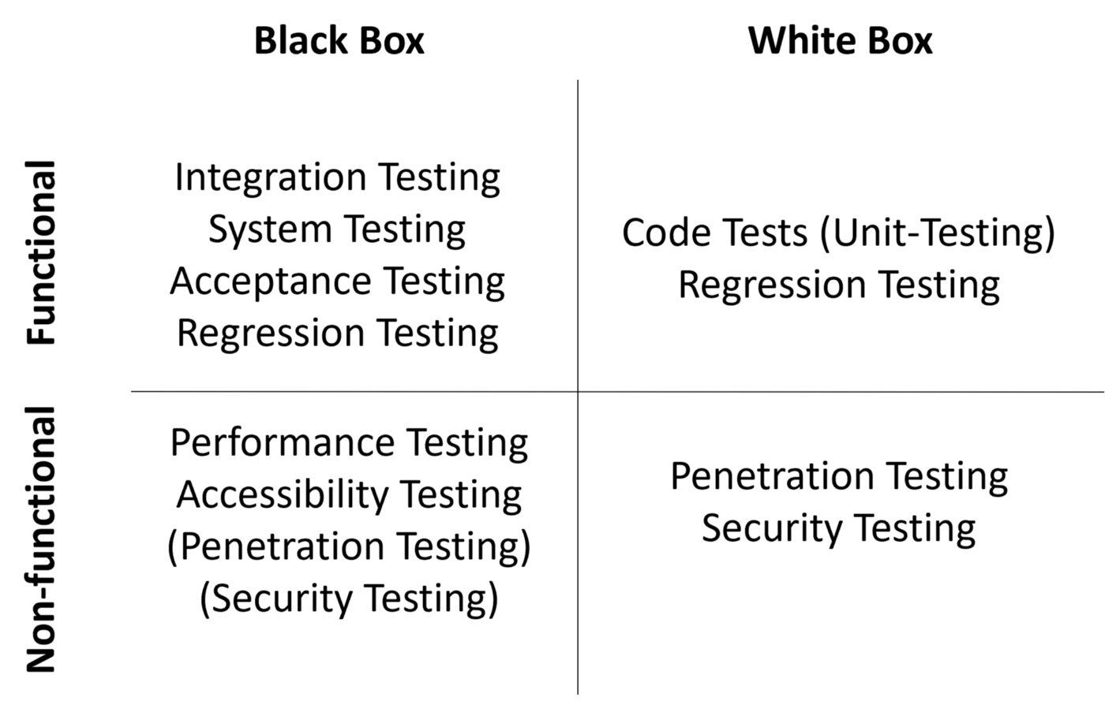

Slide 72
White Box testing
White-box testing is a testing technique which checks the internal functioning of the system. In this method, testing is based on coverage of code statements, branches, paths or conditions. White-Box testing is considered as low-level testing. It is also called glass box, transparent box, clear box or code base testing. The white-box Testing method assumes that the path of the logic in a unit or program is known.
Gray Box Testing
Gray Box Testing is a software testing technique which is a combination of Black Box Testing technique and White Box Testing technique. The internal structure, design and implementation is partially known in Gray Box Testing.

Slide 73
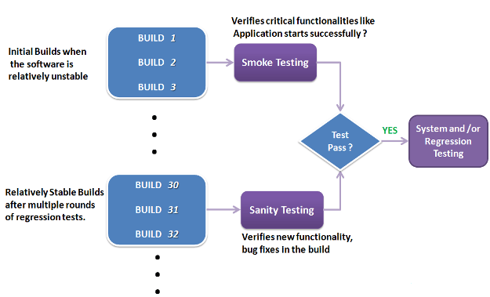
Smoke testing is executed at the initial stage of SDLC, to check the core functionalities of an application. Whereas Sanity & Regression testing are done at the final stage of SDLC, to check the main functionalities of an application.

Slide 74
End to End Testing
End to End Testing is the approach in which tester/developer always validate whether the flow of application/software from the starting point to the end point is working perfectly or not.
End to End Verification of a Gmail accounts will include the following steps:
Launching a Gmail login page through URL.
Logging into Gmail account by using valid credentials.
Accessing Inbox. Opening Read and Unread emails.
Composing a new email, reply or forward an email.
Opening Sent items and checking emails.
Checking emails in the Spam folder
Logging out of Gmail application by clicking ‘logout’

Slide 75
Integration testing
Integration testing is done to test the modules/components when integrated to verify that they work as expected i.e. to test the modules which are working fine individually does not have issues when integrated.
When talking in terms of testing large application using black box testing technique, involves the combination of many modules which are tightly coupled with each other. We can apply the Integration testing technique concepts for testing these types of scenarios.

Slide 76
What is a Test Scenario?
Test Scenario gives the idea of what we have to test. Test Scenario is like a high-level test case.
Test Scenario answers “What to be tested”
Assume that we need to test the functionality of a login page of Gmail application. Test scenario for the Gmail login page functionality as follows:
For an eCommerce Application, a few test scenarios would be
Test Scenario 1: Check the Search Functionality
Test Scenario 2: Check the Payments Functionality
Test Scenario 3: Check the Login Functionality
Test Scenario Example: Verify the login functionality

Slide 77
What is a Test Case?
Test cases are the set of positive and negative executable steps of a test scenario which has a set of pre-conditions, test data, expected result, post-conditions and actual results.
Test Case answers “How to be tested”
Assume that we need to test the functionality of a login page of Gmail application. Test cases for the above login page functionality as follows:

Slide 78
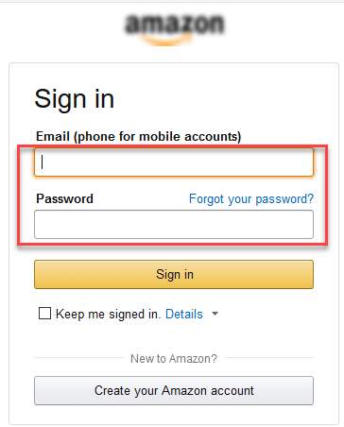
Test cases for the Test Scenario: "Check the Login Functionality" would be

Slide 79
Check system behavior when valid email id and password is entered.
Check system behavior when invalid email id and valid password is entered.
Check system behavior when valid email id and invalid password is entered.
Check system behavior when invalid email id and invalid password is entered.
Check system behavior when email id and password are left blank and Sign in entered.
Check Forgot your password is working as expected
Check system behavior when valid/invalid phone number and password is entered.
Check system behavior when "Keep me signed" is checked

Slide 80
How to write a test case
Test Case ID | Test Scenario | Test Steps | Test Data | Expected Results | Actual Results | Pass/Fail
TU01 | Check Customer Login with valid Data | Go to site www.gmail.com Enter UserId Enter Password Click Submit | Userid = user123 Password = pass123 | User should Login into an application | As Expected | Pass
TU02 | Check Customer Login with invalid Data | Go to site www.gmail.com Enter UserId Enter Password Click Submit | Userid = user123 Password = pass123 | User should not Login into an application | As Expected | Pass

Slide 81
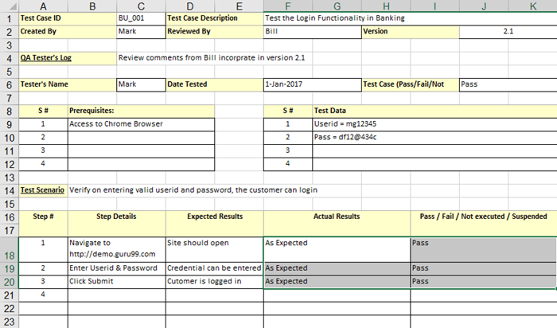

Slide 82
What is Defect/Bug Life Cycle?
Defect Life Cycle or Bug Life Cycle in software testing is the specific set of states that defect or bug goes through in its entire life. The purpose of Defect life cycle is to easily coordinate and communicate current status of defect which changes to various assignees and make the defect fixing process systematic and efficient.
Defect Status
Defect Status or Bug Status in defect life cycle is the present state from which the defect or a bug is currently undergoing. The goal of defect status is to precisely convey the current state or progress of a defect or bug in order to better track and understand the actual progress of the defect life cycle.
The number of states that a defect goes through varies from project to project. Below lifecycle diagram, covers all possible states
New: When a new defect is logged and posted for the first time. It is assigned a status as NEW.
Assigned: Once the bug is posted by the tester, the lead of the tester approves the bug and assigns the bug to the developer team
Open: The developer starts analyzing and works on the defect fix
Fixed: When a developer makes a necessary code change and verifies the change, he or she can make bug status as “Fixed.”
Pending retest: Once the defect is fixed the developer gives a particular code for retesting the code to the tester. Since the software testing remains pending from the testers end, the status assigned is “pending retest.”
Retest: Tester does the retesting of the code at this stage to check whether the defect is fixed by the developer or not and changes the status to “Re-test.”

Slide 83
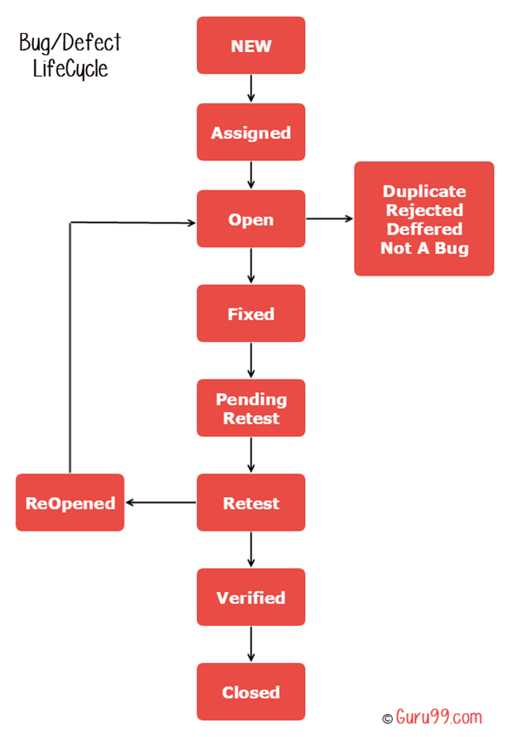

Slide 84
Verified: The tester re-tests the bug after it got fixed by the developer. If there is no bug detected in the software, then the bug is fixed and the status assigned is “verified.”
Reopen: If the bug persists even after the developer has fixed the bug, the tester changes the status to “reopened”. Once again the bug goes through the life cycle.
Closed: If the bug is no longer exists then tester assigns the status “Closed.”
Duplicate: If the defect is repeated twice or the defect corresponds to the same concept of the bug, the status is changed to “duplicate.”
Rejected: If the developer feels the defect is not a genuine defect then it changes the defect to “rejected.”
Deferred: If the present bug is not of a prime priority and if it is expected to get fixed in the next release, then status “Deferred” is assigned to such bugs
Not a bug:If it does not affect the functionality of the application then the status assigned to a bug is “Not a bug”.

Slide 85
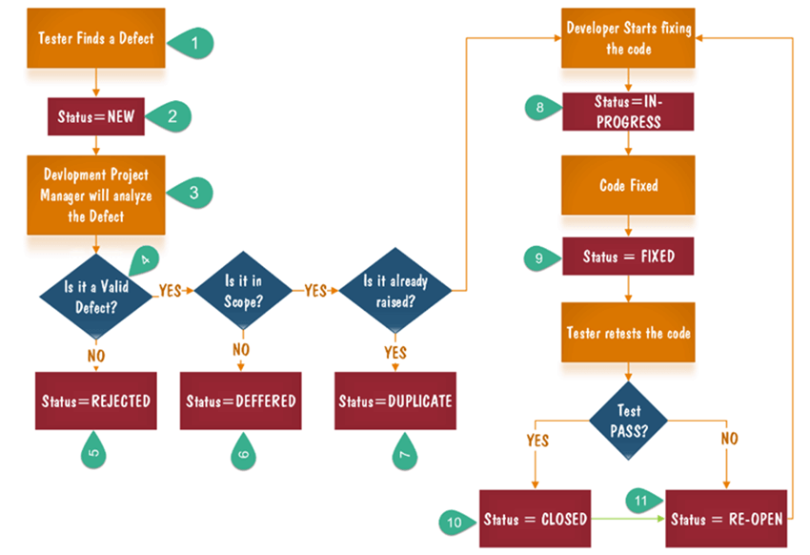
Defect Life Cycle Explained

Slide 86
Tester finds the defect
Status assigned to defect- New
A defect is forwarded to Project Manager for analyze
Project Manager decides whether a defect is valid
Here the defect is not valid- a status is given “Rejected.”
So, project manager assigns a status rejected. If the defect is not rejected then the next step is to check whether it is in scope. Suppose we have another function- email functionality for the same application, and you find a problem with that. But it is not a part of the current release when such defects are assigned as a postponed or deferred status.
Next, the manager verifies whether a similar defect was raised earlier. If yes defect is assigned a status duplicate.
If no the defect is assigned to the developer who starts fixing the code. During this stage, the defect is assigned a status in- progress.
Once the code is fixed. A defect is assigned a status fixed
Next, the tester will re-test the code. In case, the Test Case passes the defect is closed. If the test cases fail again, the defect is re-opened and assigned to the developer.
Consider a situation where during the 1st release of Flight Reservation a defect was found in Fax order that was fixed and assigned a status closed. During the second upgrade release the same defect again re-surfaced. In such cases, a closed defect will be re-opened.

Slide 87
THANK YOU

